Slide 1
Ghostbusters
Mitchell Boullt, Caroline Christy, Allison Faulkner, Justin Ho, Madison Lusane

Slide 2
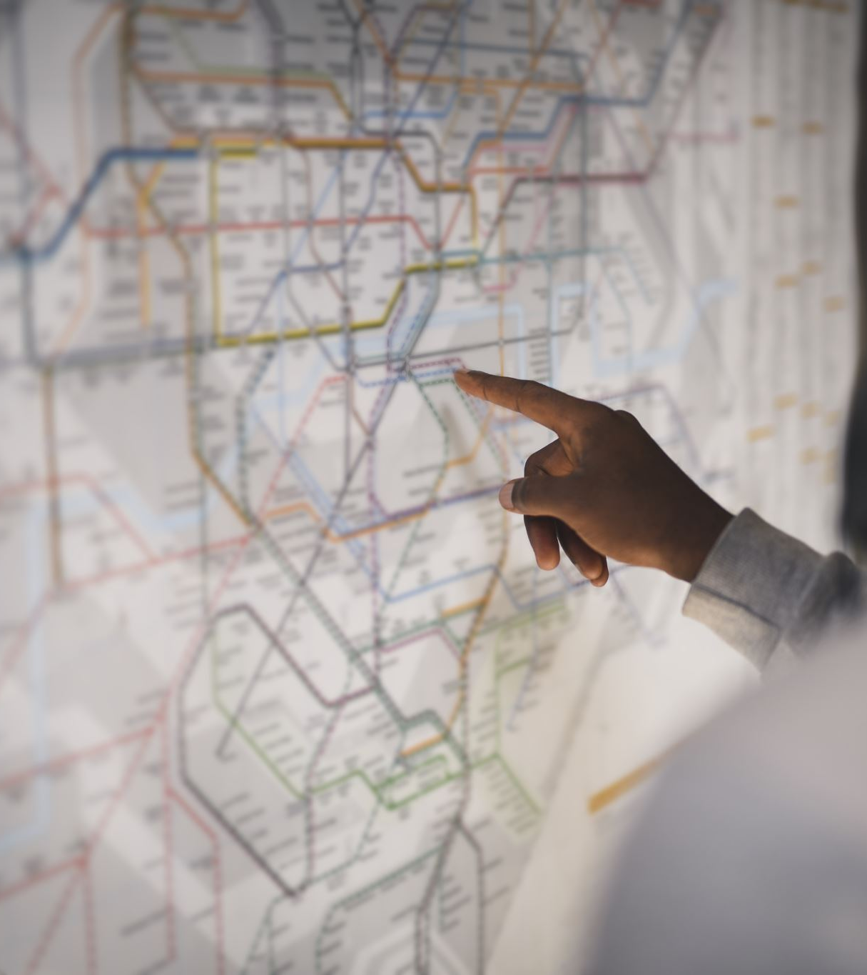
Purpose of the project
The purpose of the project is to analyze different paranormal activity sightings such as haunted houses, ufo sightings , and big foot sightings. After we gathered all the information, we then created a database combining all three aspects. After that, we made maps and graphs to be able to interpret our findings by location and time.

Slide 3

Datasets used
The data we obtained from data.world are:
BigFoot
UFO
Haunted Houses
Notes:
Can go into further detail of the datasets like in repository

Slide 4
Libraries used
CSV
Gmaps
Json
Pandas
Pprint
Requests
Time
Unicodedata
Unicode

